Slide 1

So you want to be a Tech Lead?
20 X
10 things you need to do. Joel Hammond-Turner e: joel@hammond-turner.org.uk w: www.hammond-turner.org.uk t: @Rammesses
Notes:
Welcome everyone
Introduce yourself as Tech Lead for Landmark’s new Quest Central product
Describe Quest Central in general terms – challenging
10 things are MY opinion
Some technical, some soft skills
Feel free to ask questions, give YOUR opinion or heckle – this is a conversation.

Slide 2
First… What the heck is a Tech Lead anyway?

Slide 3

A Tech Lead is …
A Developer?
Notes:
Pat Kua yesterday – top 5 mistakes - You’re a tech lead – write code / don’t write code!
Start with something controversial – definitely marmite
Hands up: Who has / uses project or company-wide coding standards
Ask victim: Who defines / maintains them? Are they enforced?

Slide 4
0:03:00
10 things…
Thing #1
Coding Standards
Notes:
My opinion – they ARE a good thing – consistency
Need to be brought in early on a project
File -> New Project
At Landmark
- Implemented as a Nuget package
- Enforced on CI builds
“Don’t like it!”
- Tough
- Breaks build

Slide 5
Agree them!
Document them!
Development handbook
Enforce them!
Code Reviews
StyleCop / FxCop / NDepend
Break the build!
Thing #1
Coding Standards
Notes:
Documented in a “Developer Handbook”
- Mostly cut & paste
- also covers…

Slide 6
0:09:00
10 things…
Thing #2
Process Automation
Notes:
No excuse these days to not have process automation
Hands up: Anyone had to live without CI? Any still?
Ask victim: How do you sleep at night? ☺
Even if not end-to-end CD, benefits
- Repeatability
- Tracability
- Testing
Automate all the things.

Slide 7
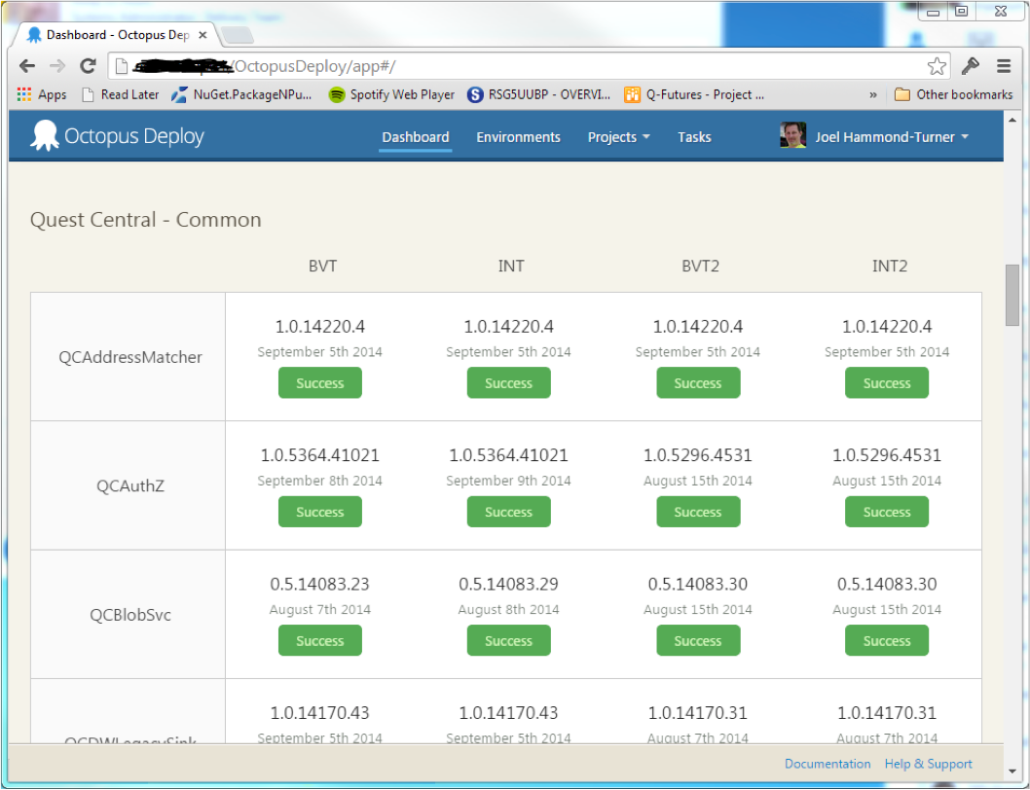
Thing #2
Process Automation
Notes:
At Landmark
- source / work items in VSO
- on-prem build server
- automated release management with OctopusDeploy
- not DB yet
Hands up: Who’s loving OctopusDeploy? Or other release management app?
Need to be strong about it
- Developer that deployed from his desktop in a rush – loads of come-back
Get it in early.
NOT just a dev-ops responsibility – it’s YOURS – devs benefit after all!

Slide 8

Tech Lead responsibility
From the start
Constantly Maintained
Broken builds / failing tests are not acceptable
Release Management
OctopusDeploy
One-click
Desktop builds are evil
DBs are STILL a problem.
Redgate & OctopusDeploy !
Thing #2
Process Automation

Slide 9

A Tech Lead is …
A Business Analyst?
Notes:
“What the heck? Business analysis?”
Not involved / working CLOSELY with BAs => Not in a position to lead development of product.
- conflicts between requirements and implementation
- pragmatism in both
- clarity and understanding
- user experience vs system functionality
Story: 650 item requirements catalog
- No UX hints
- from “audit when a is set to ‘NNN’
- User Admin 1 liner

Slide 10
0:13:00
10 things…
Thing #3
Personas
Notes:
Persona based analysis

Slide 11
The traditional “User Story”
“As a Booking Agent
I want to be able to confirm a key-pickup appointment
So that the Scheduling System can plan the working day correctly for the surveyors.”
Thing #3
Personas
Notes:
Focused on the system
No UX hints
“Roles” aren’t human enough

Slide 12


How Haley books a survey
Haley calls Tom at Friends Estate Agents on The High Street to check their opening times to pick up the keys for Flat 1, 26 Lower Back Street.
She then picks the suggested afternoon slot and saves the provisional appointment for the mortgage valuation survey that will be given to one of the Staff Surveyors.
Thing #3
Personas
Notes:
Focuses on Haley’s workflow
- informs UX
Describes requirements in human terms
Hints at UI
Story: “That’s not Haley!”
RandomUser.me

Slide 13
Humanises requirements
Describe the user’s working process, NOT the system’s operation
Use a photo
People are hard-wired to recognise / remember faces
Focuses on the UX
Your product WILL be better
Thing #3
Personas

Slide 14
0:17:00
10 things…
Thing #4
Sketches
Notes:
No-one wants winforms style UI – bootstrap, etc
UX is the differentiator – needs to be aligned with user’s workflow
War cry!

Slide 15

Thing #4
Sketches
To the whiteboard,
Robin!

Slide 16
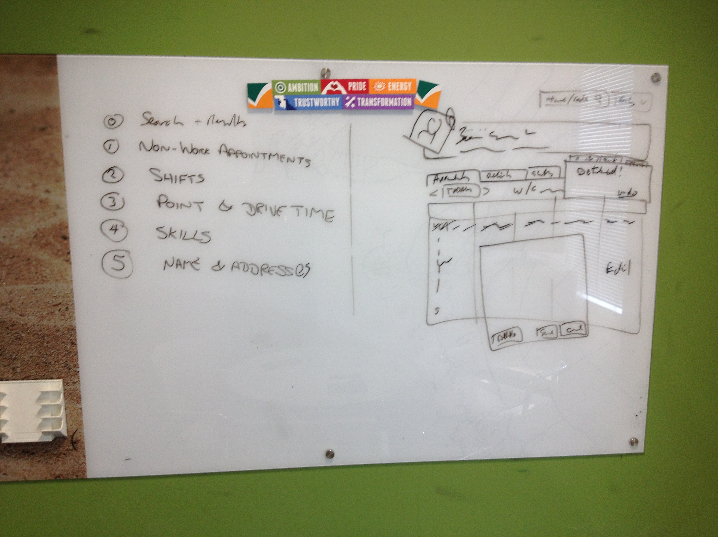
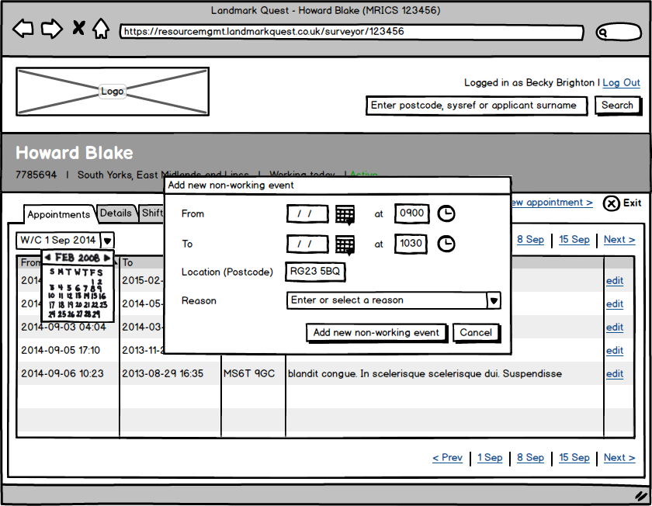
Thing #4
Sketches
Notes:
Prototypes / Wireframes / Sketches
- are cheap
- fast to develop
- clear
Do use a real UX consultant tho’…
- fun to work with
Cut to heart of user’s workflow
Don’t need / WANT photoshops of every screen
(design agencies DO want them however)
Learn the tools
- you and BA are cheaper
CHANGE HAPPENS
Communicates understanding of requirements
- supports the acceptance criteria
- NOT a substitute tho’
- testing

Slide 17
Sketches
Fast, cheap, expressive
Whiteboard / Index cards
Balsamiq / Prototyping on Paper (iPhone)
Improves Dev’s understanding of BA’s intent
Focuses on the UX
Your product will be better!
Thing #4
Sketches
Notes:
Check time here.
Should be at 25 minutes

Slide 18
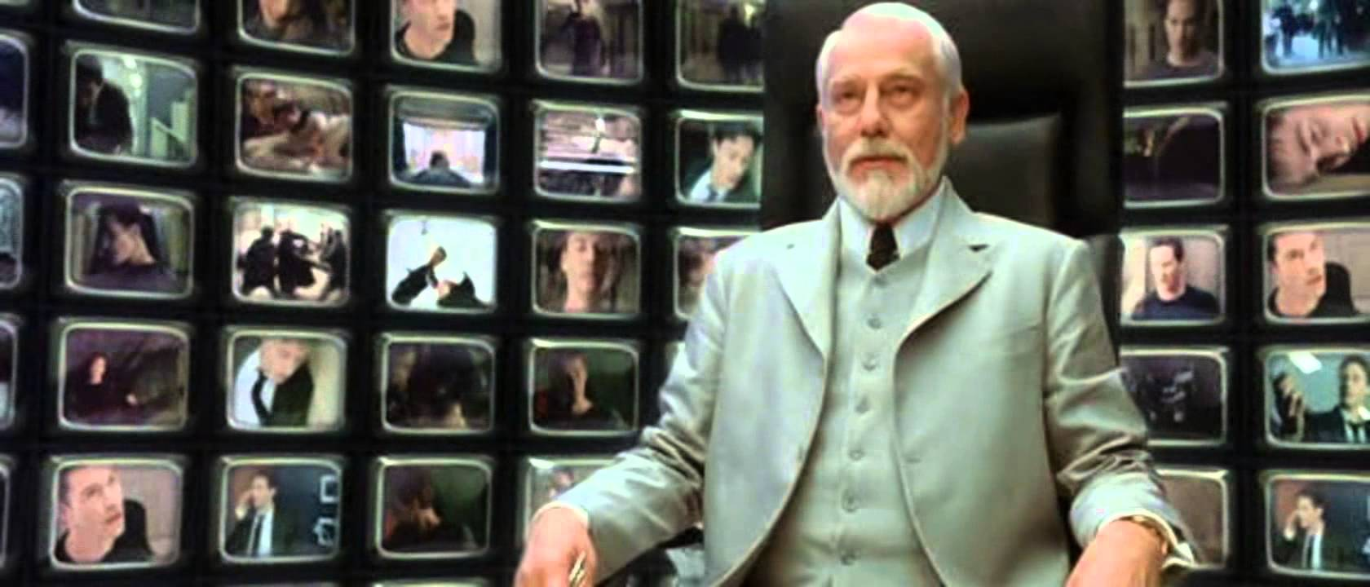
A Tech Lead is …
An Architect?
Notes:
Hands up: Who has a genuine Software Architect in your org / project / team?
Ask a victim: how much time do you spend with him/her per week on the architecture?

Slide 19
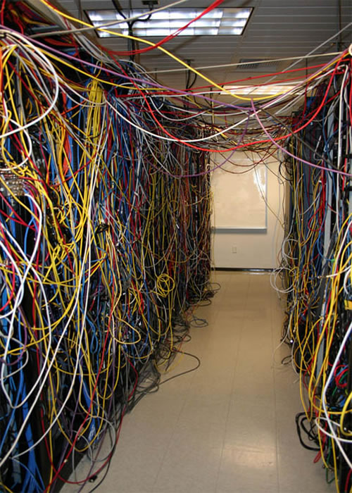
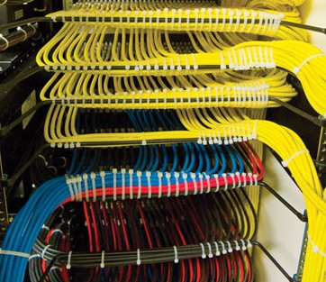
Which does your code / architecture
feel like?
Notes:
Is it
- by committee?
- by decree?
- by collaboration (between you and him/her)?
Tech Lead is responsible for implementing the architecture
- pragmatism vs ivory tower
- big bang vs evolutionary
Plenty of tools in the arsenal for SOLID .Net code. (SOLID principle)
Don’t compromise too much

Slide 20
0:21:00
10 things…
Thing #5
NuGet Libraries
Notes:
Favorite tool
PACKAGED COMPONENTISED LIBRARIES
Yes, NuGet all the things
Hands up: Who’s using NuGetted libraries internally?
- How’s it working?
- What sort of things are NuGetted?

Slide 21
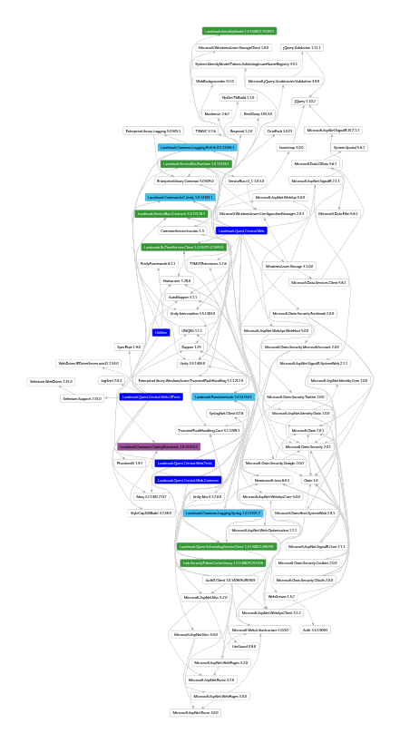
Thing #5
NuGet Libraries
Notes:
At Landmark
- Common code
- Logging
- Email / SMS sending
- Diagnostics
- Validation
- APIs / Services
- create .Net client package for deployed services
- testability – mockability – strongly typed APIs
- DALs
- re-use for tools / admin interfaces, etc
Get it right = win
Story: How QM product reduced build time from 48 minutes to 6

Slide 22
Extract common code
Including DALs
Test it to death
Extract APIs
Provide clients
Test it to death
Thing #5
NuGet Libraries
NuGet all the things!
Notes:
Story: How I found a test harness spinning up a local instance of a real service – from an entirely different solution
- GOING to be fixed with a client package.

Slide 23
0:25:00
10 things…
Thing #6
Tech Debt
Notes:
Can I hear the groans?

Slide 24

Thing #6
Tech Debt
Notes:
How often was this you, looking at some debt-ridden code.
Make it better
– a little at a time
- diagnostics / health / metrics
FOCUS on the worst bits first.
Story: Logging in Quest Central
- applied to a component – provided info for a bug fix within 20 minutes.

Slide 25
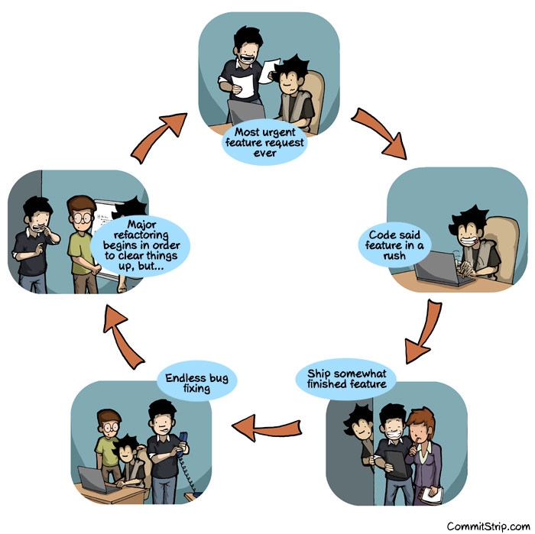
Thing #6
Tech Debt
Notes:
Persuading PMs that it’s required is the hard part.
Don’t get disheartened
On-board architect helps!
Note debt as you go

Slide 26
Understand your Tech Debt
What are the real pain points?
No-one else is likely to push for it!
Plan to reduce it
Little & Often
Make your developers apply “Boy Scout” principle
Get it right first time?
Thing #6
Tech Debt

Slide 27
0:29:00
10 things…
Thing #7
MDDs & POCs
Notes:
Always going to have to embrace change
Two essential tools are…

Slide 28
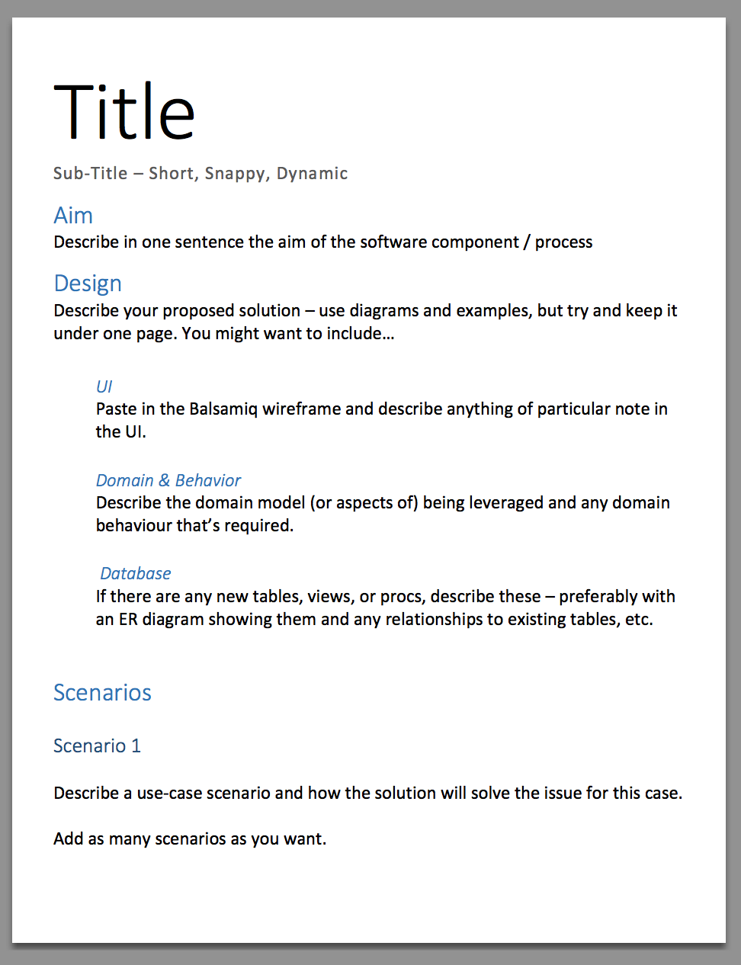
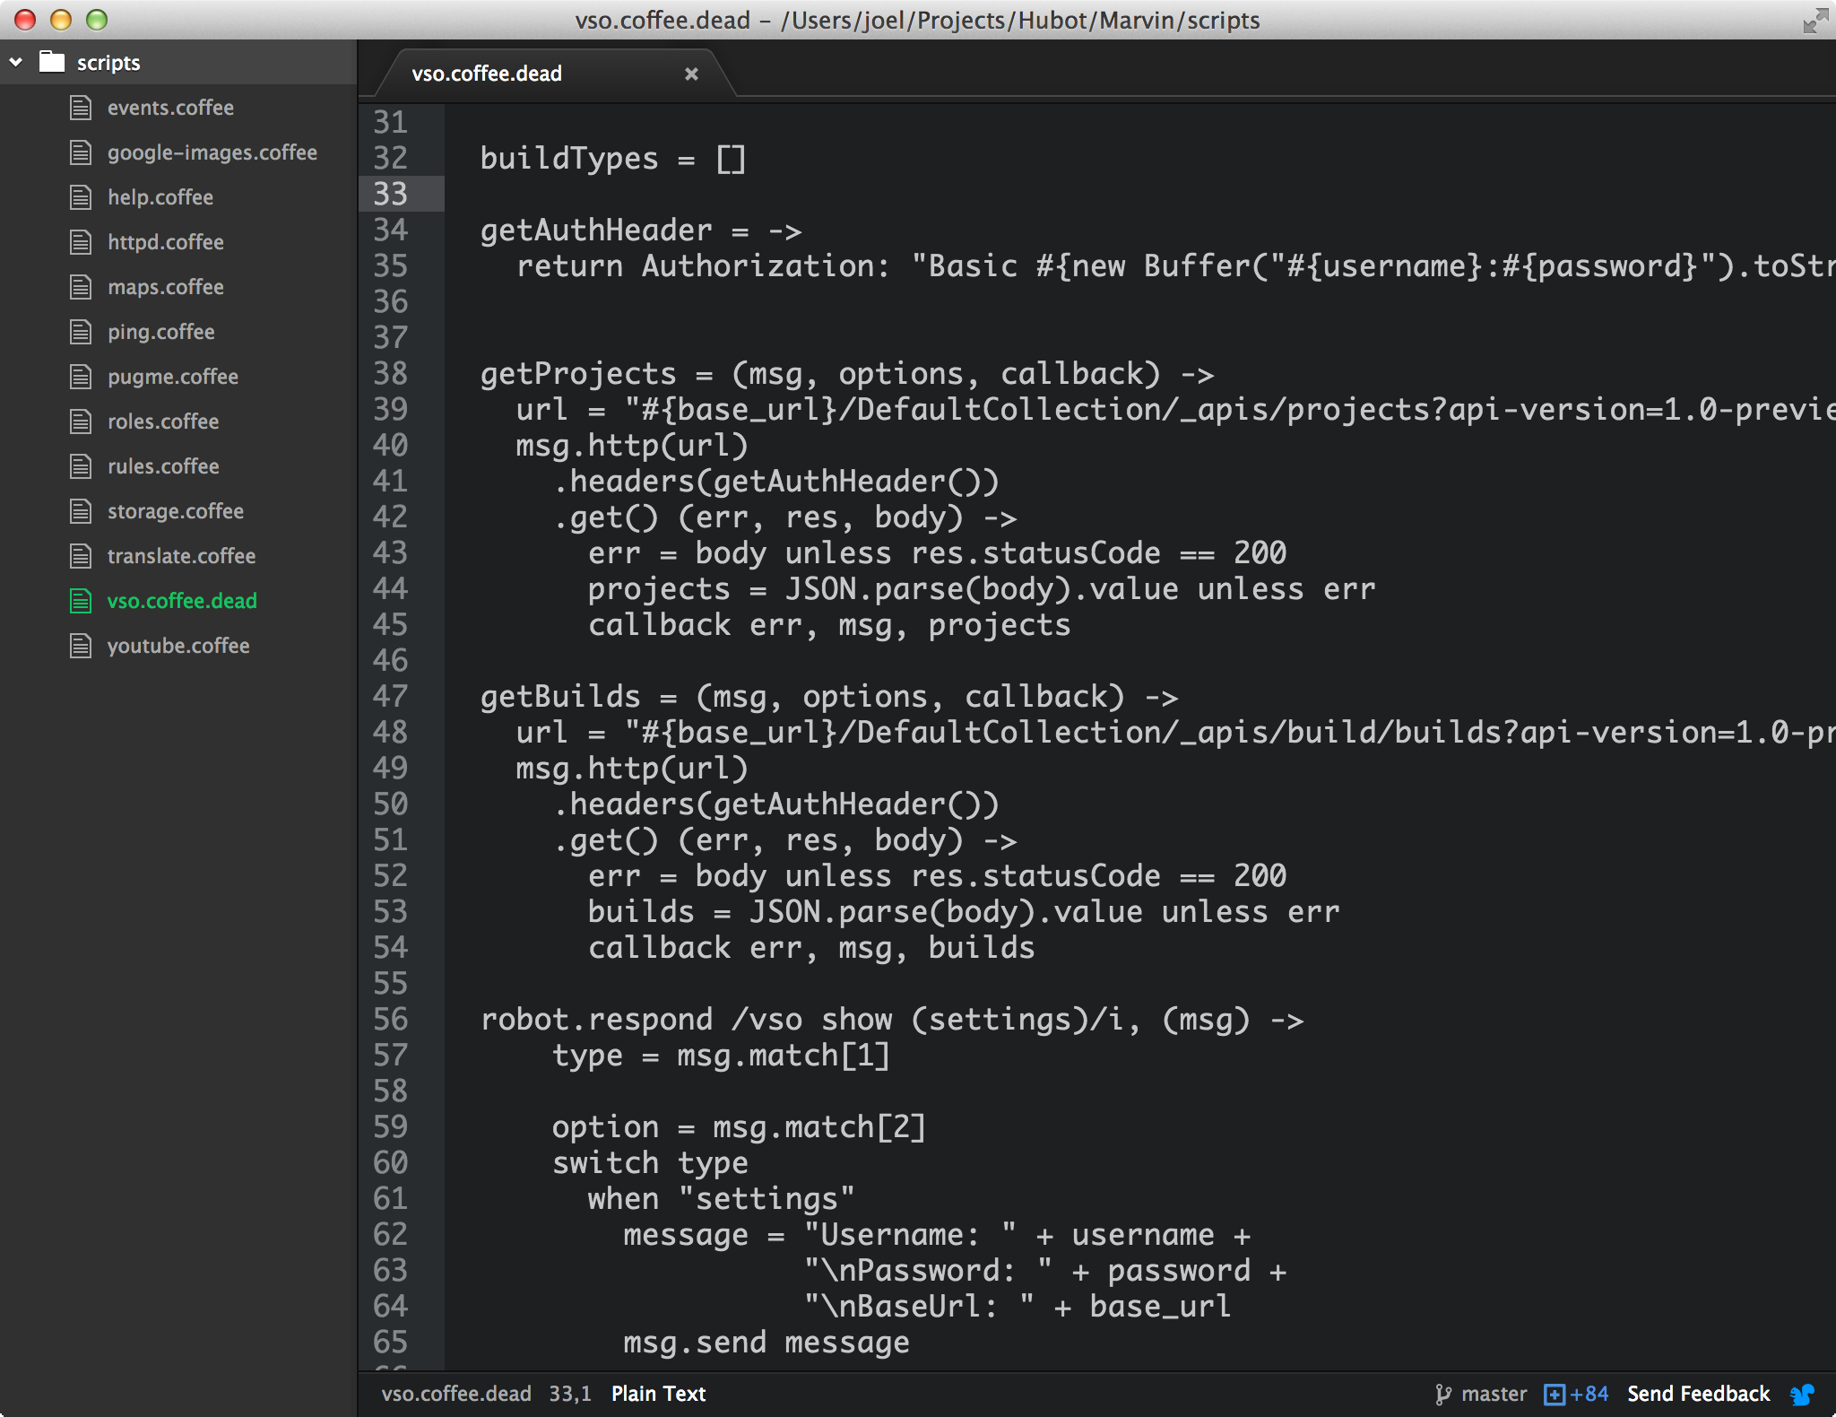
Thing #7
MDDs & POCs
Notes:
I know what a POC is, but what’s an MDD?
Mini – scope limited
Design – does what it says on the tin
Document – live document – should change over time
Shared and reviewed by the team.
NOT written by the Tech Lead – give others a chance!
AT LANDMARK
Used to help devs focus on what’s being implemented
Exposes complexity / interactions
Should take an hour to write – NO MORE
Simple template
PoC – when implementation issues are unknown
NOT just “Hello World” – address real issue.
Provides a template for a REAL implementation.

Slide 29
Use Mini Design Docs
Clarity of purpose
Discover Interactions
Expose issues with planned implementation
LIMITED SCOPE
Use Proofs-of-Concept
Solve a real problem (not “Hello World”)
Shared in source control
$/Experiments
Thing #7
MDDs & POCs

Slide 30

A Tech Lead is …
A Project Manager?

Slide 31
0:33:00
10 things…
Thing #8
Sprint Planning
Notes:
Everyone “does” planning… As a tech lead do you drive it for your team?
Story: Sprint planning where new stories appeared from considering user’s workflow & interactions.
Be strong – push back – backlog stories

Slide 32
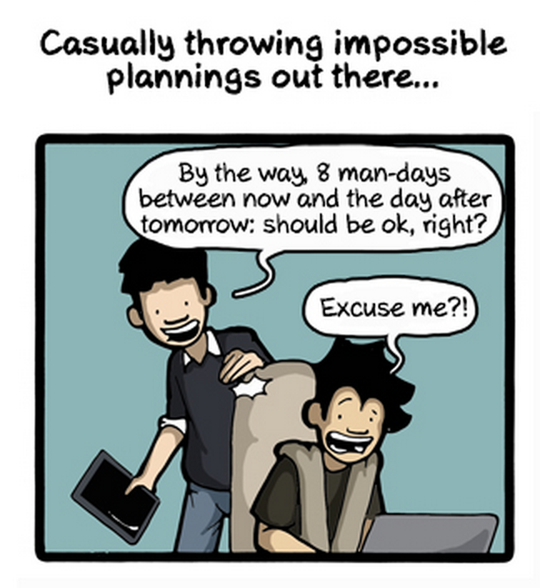
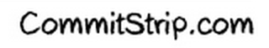
Thing #8
Sprint Planning
Notes:
Hands up: Who can sympathise with this? Who had this in the last week?
Story: Customer feedback changing workflow.
Can change be catered for?
PBIs / Balsamiq on the fly

Slide 33
Drive sprint planning
“Help” your PM by editing stories / estimates
Ask every member of the team to contribute
Don’t underestimate
Especially under pressure from management
Justify estimates with rationales
Expose hidden complexity with Persona-based stories.
Change happens – live with it!
Thing #8
Sprint Planning

Slide 34
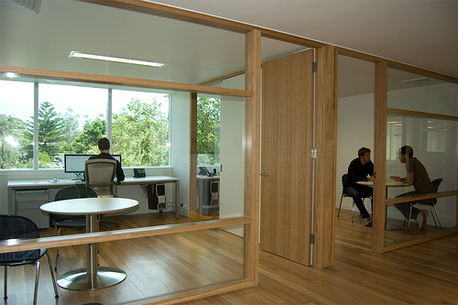
A Tech Lead is …
Available?

Slide 35
0:37:00
10 things…
Thing #8
Listen, Appraise, Decide

Slide 36
Open door policy
Always be ready to take the headphones off !
No stupid questions
Just ones that need answers
Be ready to discuss
Especially if the issue is contentious
Be objective…
Thing #9
Listen, Appraise, Decide

Slide 37
You’re not always right!
(just mostly always ☺)
Team involvement in process
Get agreement wherever possible
Decide on one approach where needed
Don’t let your team work without guidance
Follow through on decisions
Un-making is not allowed!
Thing #9
Listen, Appraise, Decide

Slide 38
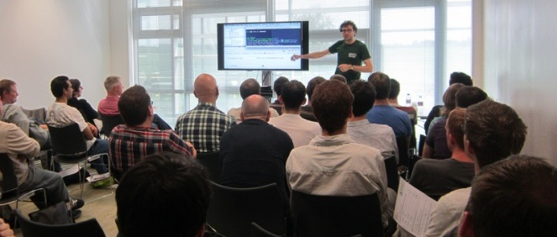
A Tech Lead is …
A Mentor?

Slide 39
0:41:00
10 things…
Thing #10
Learning & Sharing

Slide 40

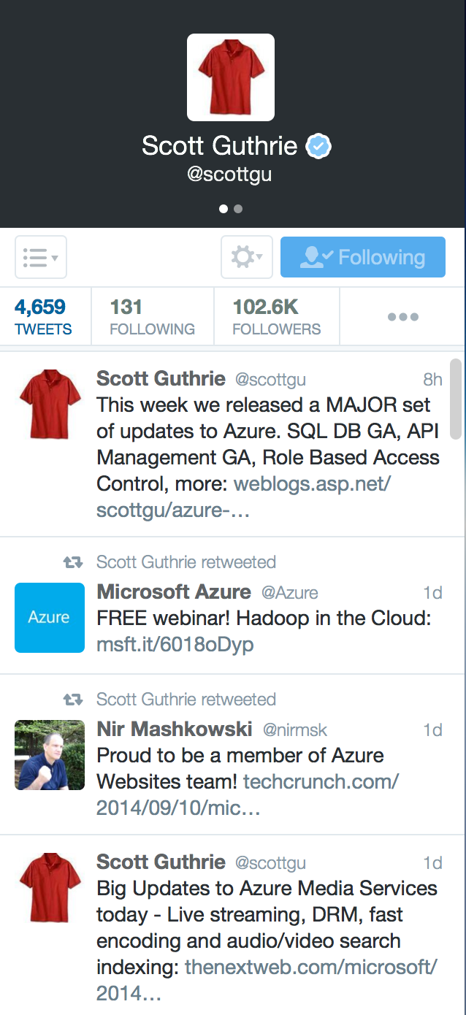


Thing #10
Learning & Sharing
Notes:
Ask: How do you lot keep up to date with the state of the art?
Do you take time each day?
You MUST.
Can’t support your team if you’re behind the curve.
My faves…

Slide 41
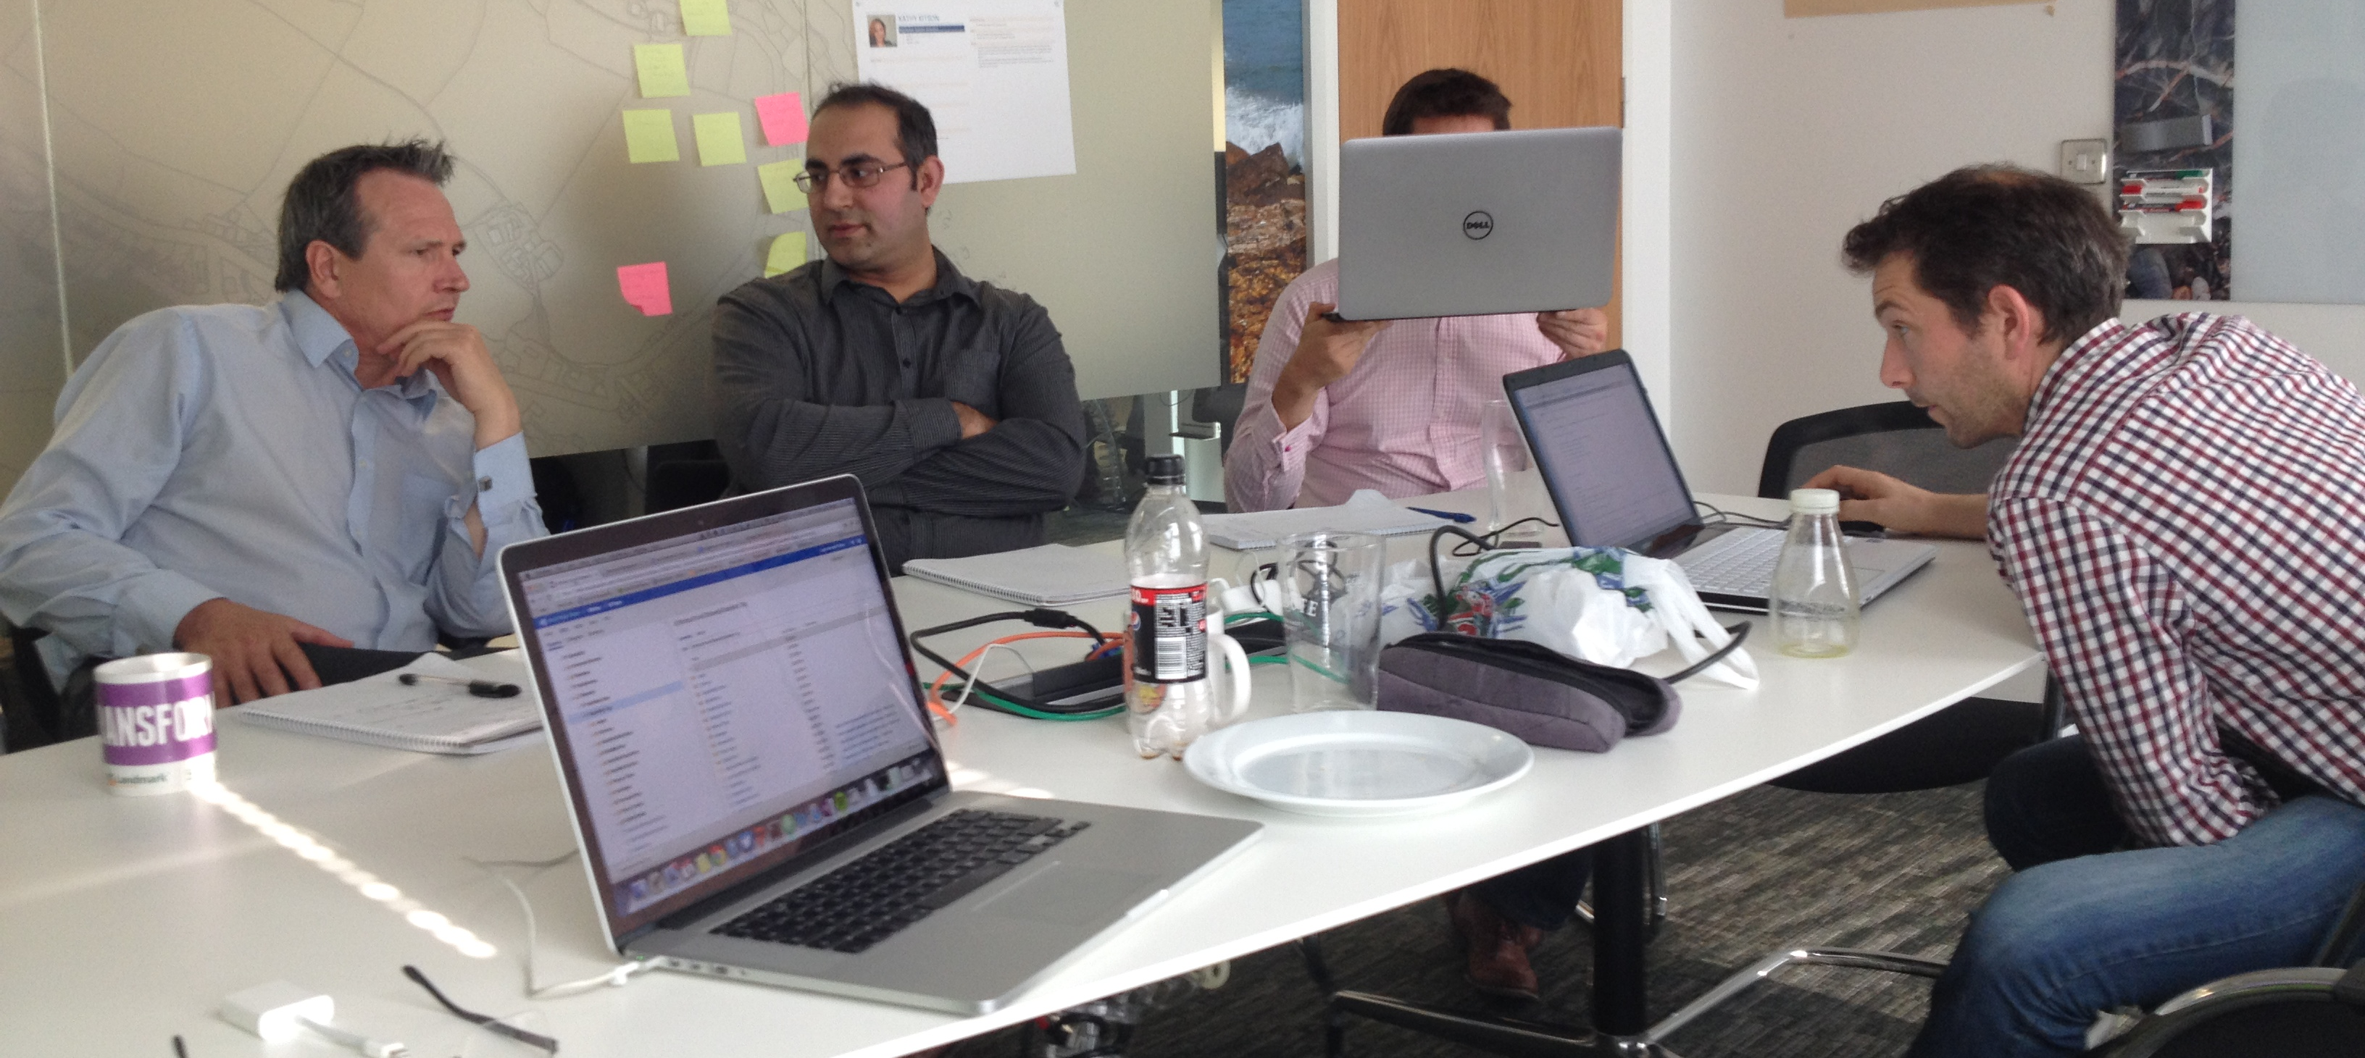
Thing #10
Learning & Sharing
Notes:
Share the love
Pairing
one-on-ones
team show-n-tells
Techtalks

Slide 42
Learn something new
Every Day
Twitter / MSDN / Pluralsight
Chris Alcock’s “Morning Brew”
Share something new
Every Day
Mentoring / Pairing
TechTalks / Open Forum Reviews
And SmartDevs UG presentations!
Thing #10
Learning & Sharing

Slide 43
0:45:00
Where’s the Pizza?

Slide 45
Thing 11: …
0:00:00
New!
Break down your
Requirements

Slide 46
Thing 11: Break down your Requirements
New!
Implement Quick Search
Create Web App (inc build & deployment)
Search page (controller / view)
Authorization restriction
Tabs on Search Page
Authorization restrictions
Search box
Type-and-show-Summary (dummy API)
Type-and-show-Summary API
(depends on Search Engine)
Search button & View Results link
Log search query for audit
Browse All link
Log usage for audit

Slide 47
Thing 11: Break down your Requirements
New!
Bite-sized – NOT snack or meal-sized PBIs
From a Developer’s perspective
Business Analysts think in Features, not PBIs
Don’t get distracted by implementation details at Feature level
You’re building it, YOU break it down

Slide 48
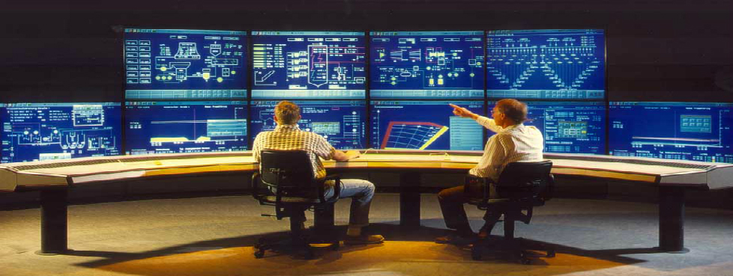
Thing 12: Instrumentation
0:04:00
New!

Slide 49



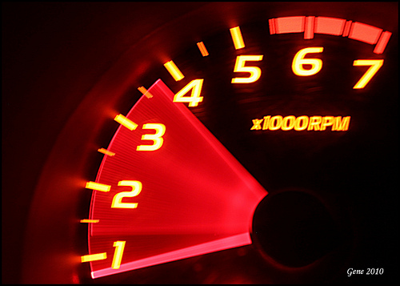

Thing 12: Instrumentation
New!
What to capture?
Counters – Incrementing or Decrementing counts
Gauges – Instantaneous Values
Meters – Rates of events
Histograms – Distribution of stream values
Timers – How long did a code block take to execute?

Slide 50
Thing 12: Instrumentation
New!
Visualise your metrics
Ask questions about your software.
Answer them visually.
Make them available.
DASHBOARD ALL THE THINGS!

Slide 51
Thing 12: Instrumentation
New!
Instrument EVERYTHING
Metrics.Net
Performance Counters
Frequency as well as Duration
Build Dashboards to surface metrics
Splunk

Slide 52
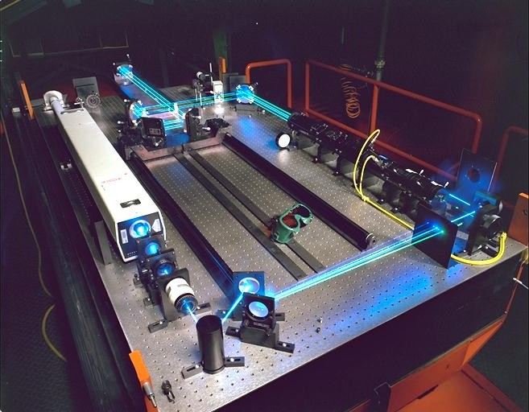
Thing 13: …
0:08:00
New!
Benchmark
Performance
Eh? What? Performance of what exactly?

Slide 53
Thing 3: Benchmark Performance
New!
What are your
Load-times ?
Chrome DevTools
BrowserPerf
PerfJankie
Part of your test suite

Slide 54
Thing 13: Benchmark Performance
New!
What are your run-times?
BenchmarkDotNet
Part of your unit tests

Slide 55
Thing 13: Benchmark Performance
New!
Depends on instrumentation - usually
Performance baseline
Against representative data sets
Compare before and after changes
Tools: Benchmark.Net, Application Insights, SQL Profiler, PerfJankie

Slide 56
Thing 14: …
0:12:00
New!
Track your
Technical
Debt

Slide 57
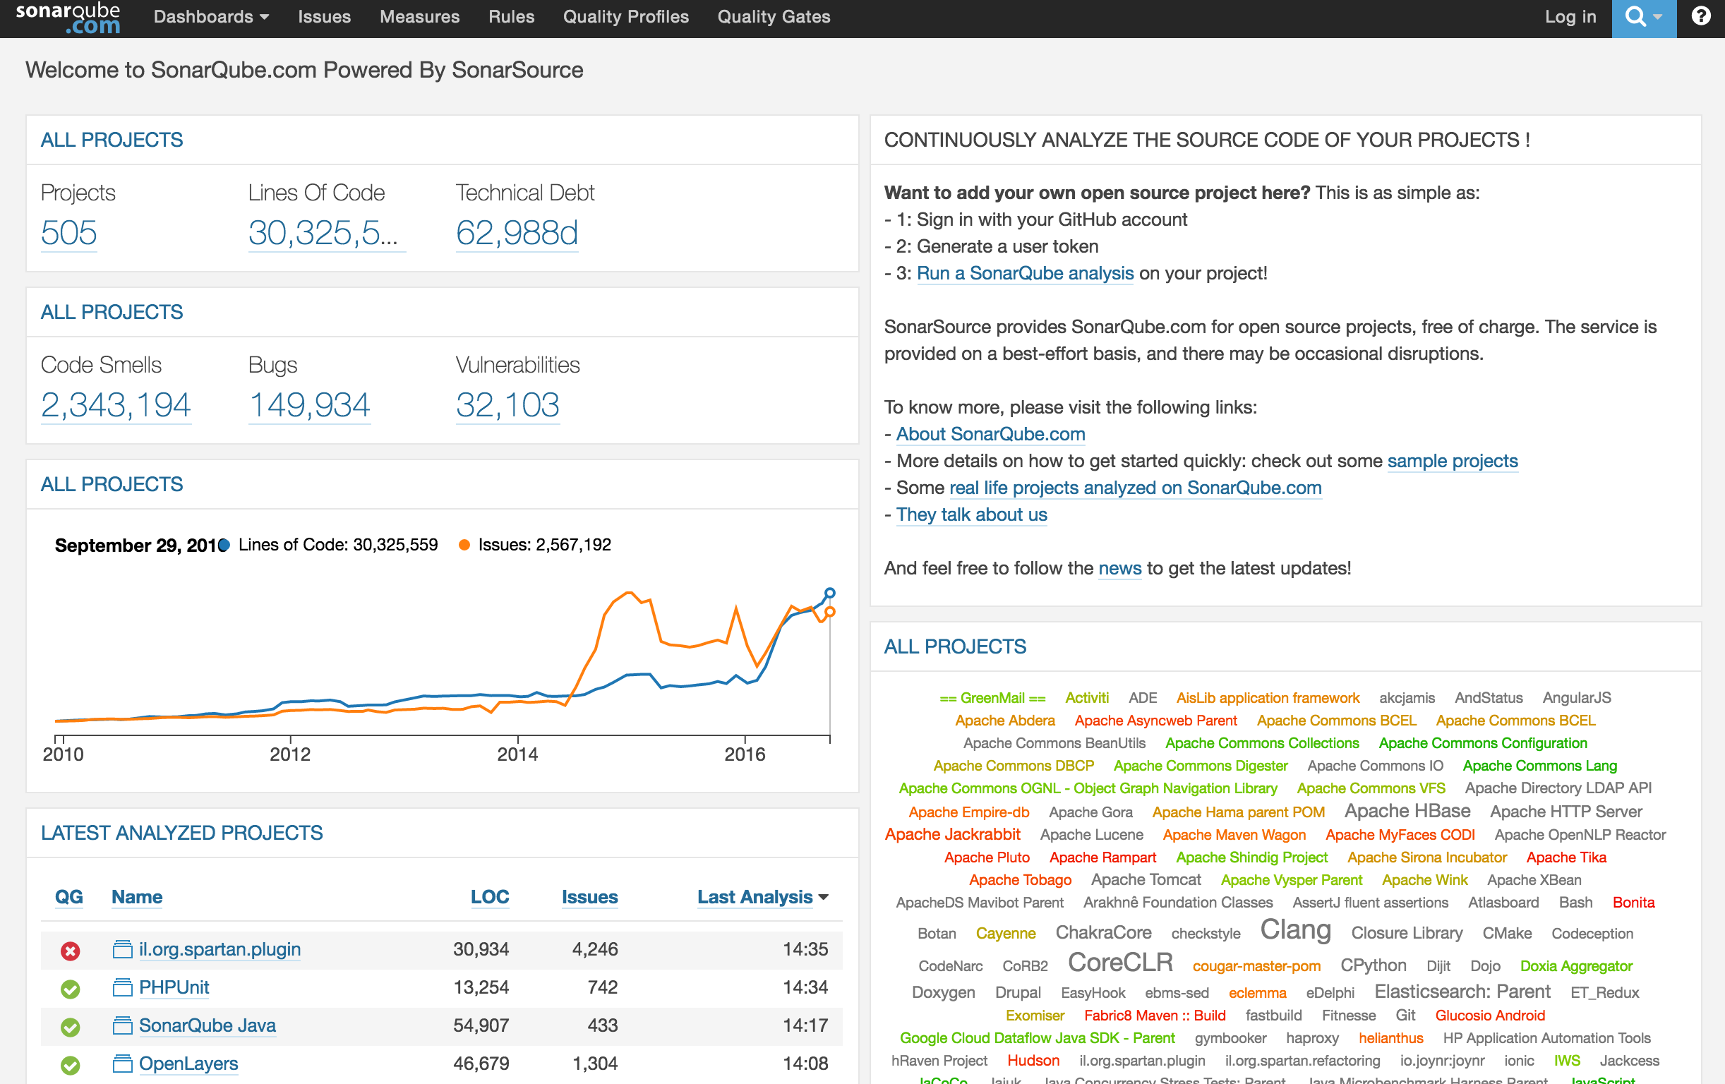
Thing 14: Track your Technical Debt
New!
SonarLint / SonarQube
Analyses source code
Records Results
Tracks changes
It’s a code quality dashboard!

Slide 58
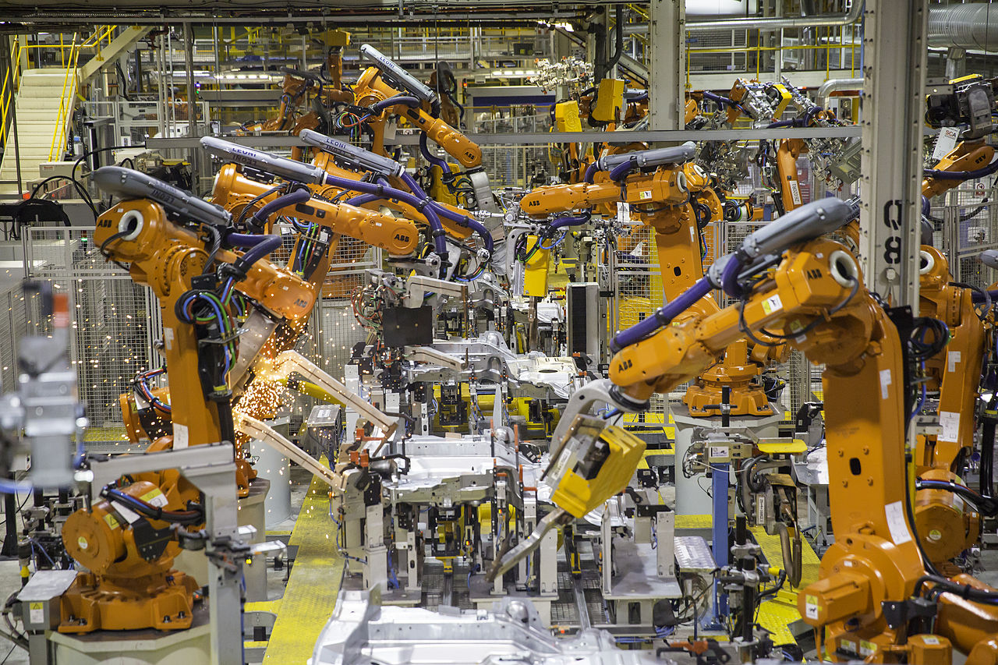
Thing 15: …
0:16:00
New!
Production
Readiness

Slide 59
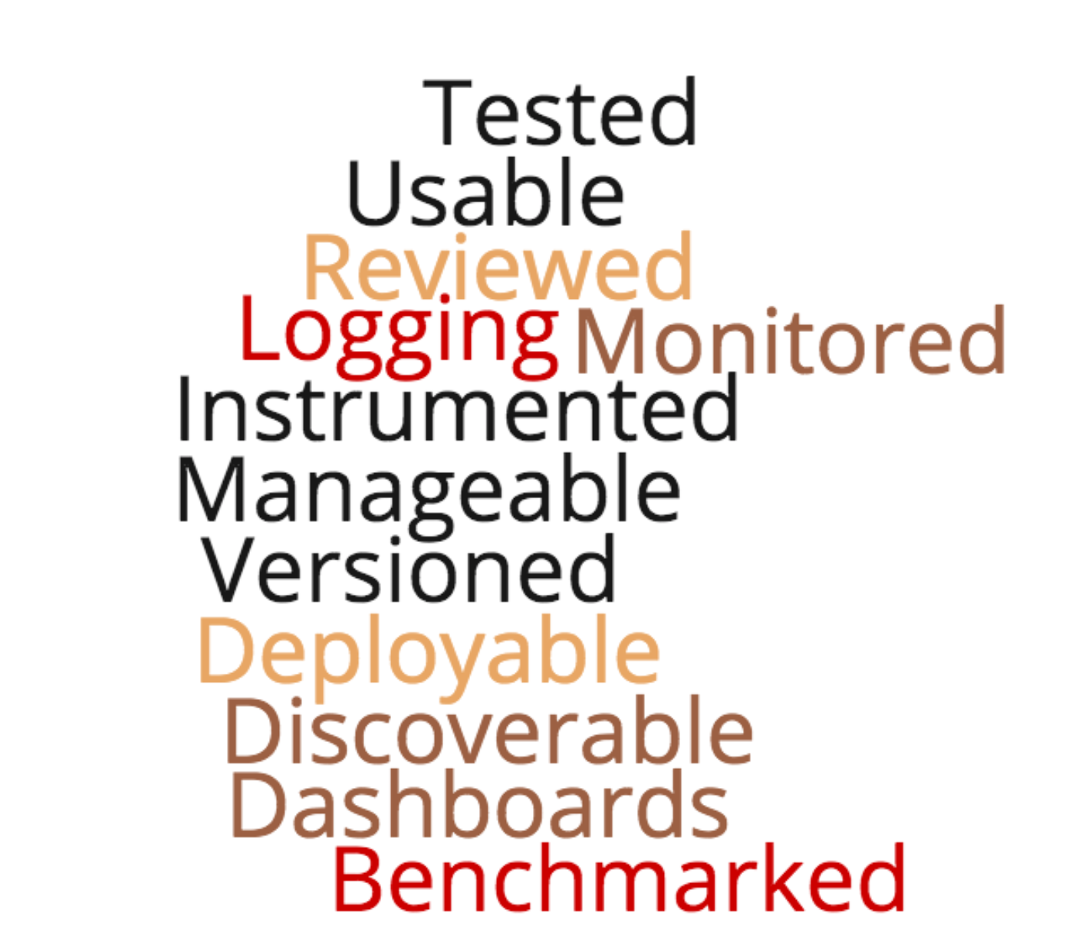
Thing 15: Production Readiness
New!
Are you Production Ready?
Is your software…
Don’t forget
all your lovely
NFRs!

Slide 60
Thing 16: …
0:20:00
New!
Step away from
the Shiny thing…

Slide 61
Thing 16: Step away from the Shiny thing…
New!
Restrain the urge to use the newest shiny stuff
New tools mean new problems
DO prototype or evaluate
But also be PRAGMATIC

Slide 62
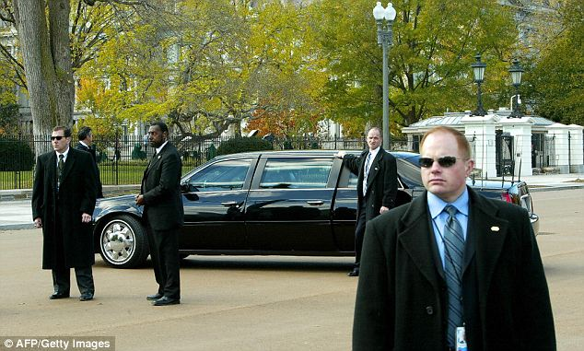
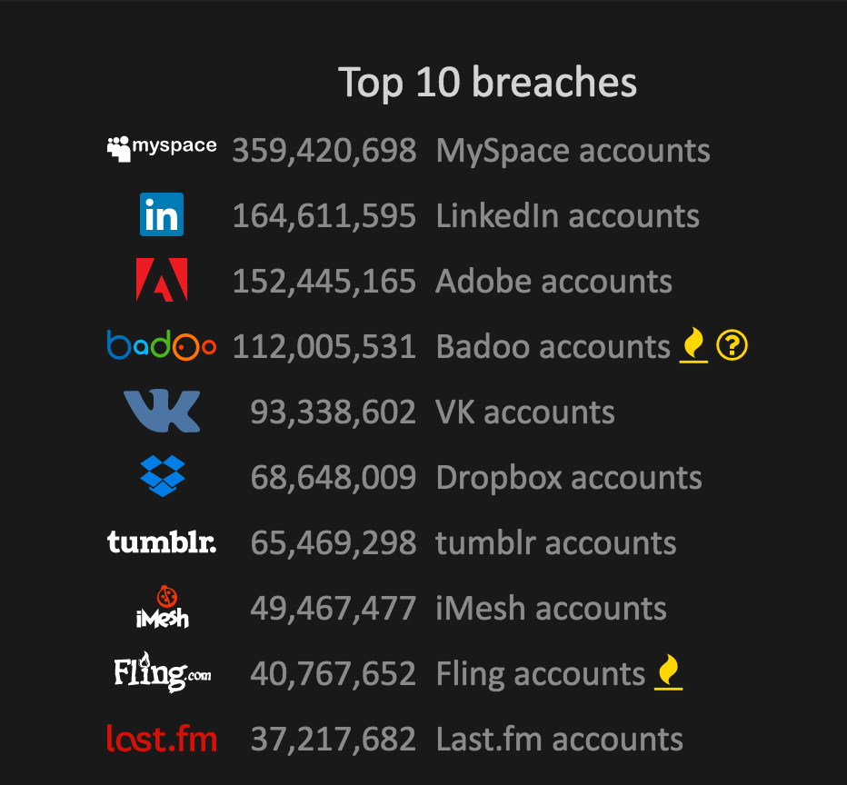
Thing 17: Security, Security, Security
0:24:00
New!

Slide 63
Thing 17: Security, Security, Security
New!
Build a security culture
Be objective
What are the attack vectors?
Where’s your data?
DON’T write it yourself
Crypto
AuthN
That one PEN test before deployment is NOT enough
Security is a Level zero feature
It’s NEVER optional

Slide 64
Thing 18: Clean Code Sessions
0:28:00
New!

Slide 65
Thing 18: Clean Code Sessions
New!
Unconference Style
Not just a moan-session
Everyone contributes
Invite Guests
Show’n’Tell SOMETHING each session

Slide 66

Thing 19: It’s all about the money…
0:32:00
New!
Do you know the
of that feature?
COST

Slide 67
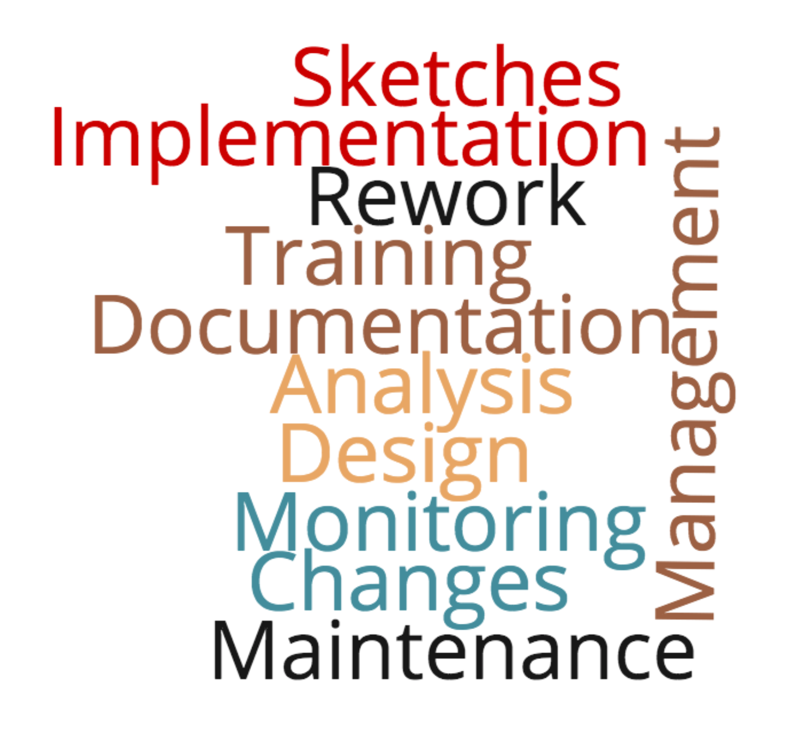
Thing 19: It’s all about the money…
New!
Consider what things actually cost…
”Yes, but let me work out the cost…”
Scaling up / out costs a lot
do you need to scale?

Slide 68

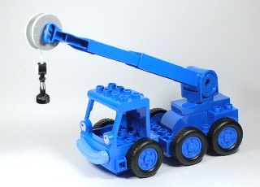
Thing 20: K.I.S.A.L.A.P
0:36:00
New!
Keep It Simple…
As Long As Possible.

Slide 69
Thing 20: K.I.S.A.L.A.P
New!
Balance YAGNI vs Product Capability
Cost of putting off complexity vs Technical Debt
Reworking a prototype for Production Readiness > Rewriting from scratch?
Don’t forget the end-game

Slide 70
In Summary
0:40:00
The Original 10 Things:
1 – Have Coding Standards
2 – Have Process & Automation
3 – Use Personas
4 – Use Sketches
5 – NuGet all the things
6 – Handle Tech Debt
7 – Use MDDs & POCs
8 – Drive Sprint Planning
9 – Listen, Appraise & Decide
10 – Learn & Share Continually

Slide 71
In Summary
The NEW 10 Things:
11 – Breakdown Requirements
12 – Instrument your Software
13 – Benchmark your Software
14 – Track your Technical Debt
15 – Ensure Production Ready
16 – Step away from the Shiny
17 – Security is never optional
18 – Have Clean Code sessions
19 – Translate work into money
20 – Keep It Simple… As Long As Possible

Slide 72
20 things…
21 X
And…
Be Confident!
Wear the
T-Shirt!

Slide 73
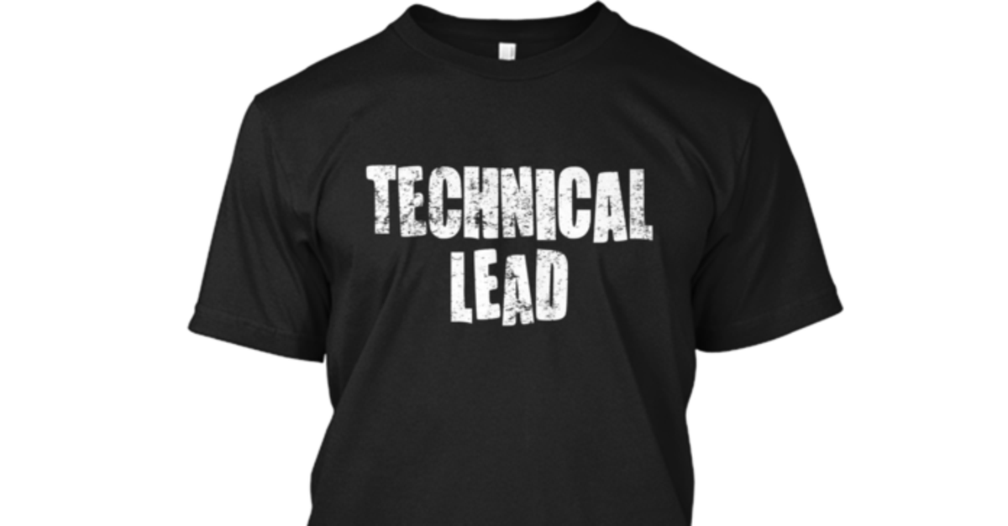
Wear the
T-Shirt!
Thing #21
Be Confident

Slide 74
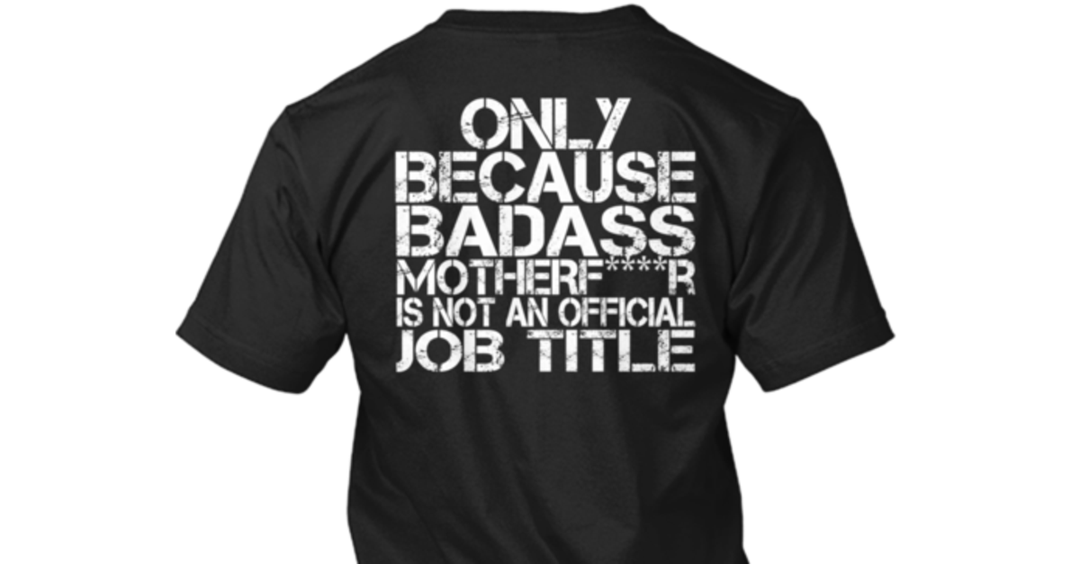
Wear the
T-Shirt!
Thing #21
Be Confident
http://teespring.com/bamftechnicallead

Slide 75
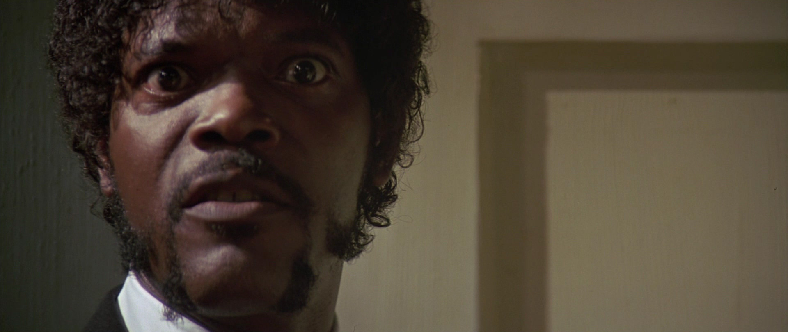
A Tech Lead is …
A Badass.

Slide 76
Questions?
0:45:00
?

Slide 77
So you want to be a Tech Lead?
21 X
10 things you need to do. Joel Hammond-Turner e: joel@hammond-turner.org.uk w: www.hammond-turner.org.uk t: @Rammesses

